Slide 1
Local big histories:
Human history
November 20, 2020
Program:
14.30-15.05: Minilecture I by Jacob Wamberg:
Local big history of Aarhus University
15.15-16.25: Students’ group work
16.40-17.15: Minilecture II by Jacob Wamberg:
Virtuality in a big history perspective

Slide 2
Minilecture I:
A local big history of Aarhus University
Jacob Wamberg
Professor of Art History, Aarhus University

Slide 3
What’s special about human history in relation to the rest of big history?
Shared virtuality: Life world is guided by an added layer of virtuality, a multitude of abstract world conceptions and perceptions, “fictions”, acquired through learning
  Ingredients of this virtual infrastructure:
    Body: Planned intentions, autonomized consciousness, autonomized emotions (feelings)
    Media: language, texts, images, rituals, music,
    sensorial environment, computers
    Ideological regimes: religion, cosmology, ethics, tribal identity, national identity, shared narratives, fiction
    Institutions: governments, municipalities, firms, money, traffic regulation
2. Technolology: The human body is adaptationally unfinished and in need of technological extensions – these are likewise developed through learning and abstract receipts
  Examples: (Media), utensils, weapons, agriculture, buildings, transport vehicles, machines, medicine

Slide 4
Human virtuality = shared world of mind and perceptions
Body:
  Mind
  Perceptions
  Surroundings:
  Extensions of mind in shared conventions (ideologies, institutions)
  Extensions of mind and perceptions in media or environment
2. Human technology = utensils manifesting physical change
(apart from media = virtual technologies) developed through learning and abstract receipts

Slide 5
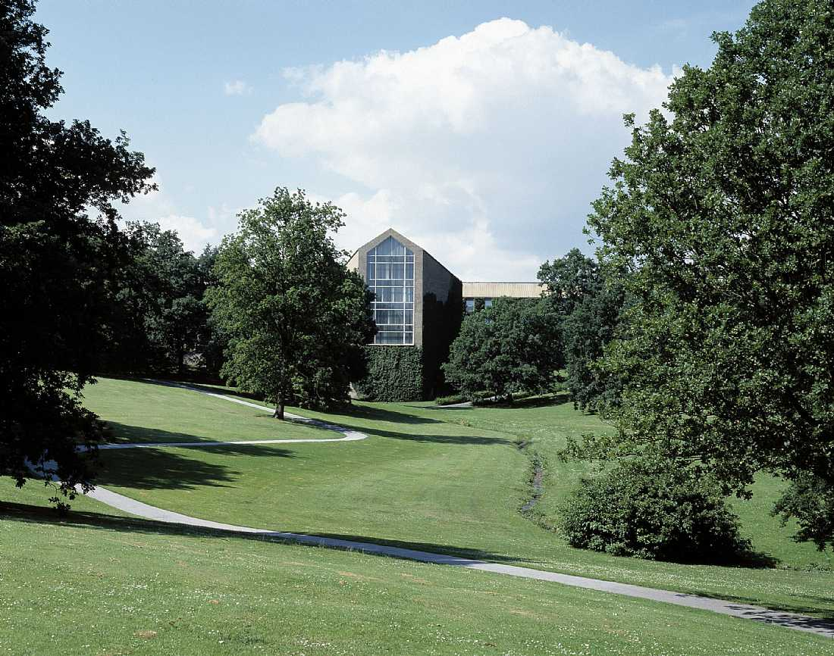
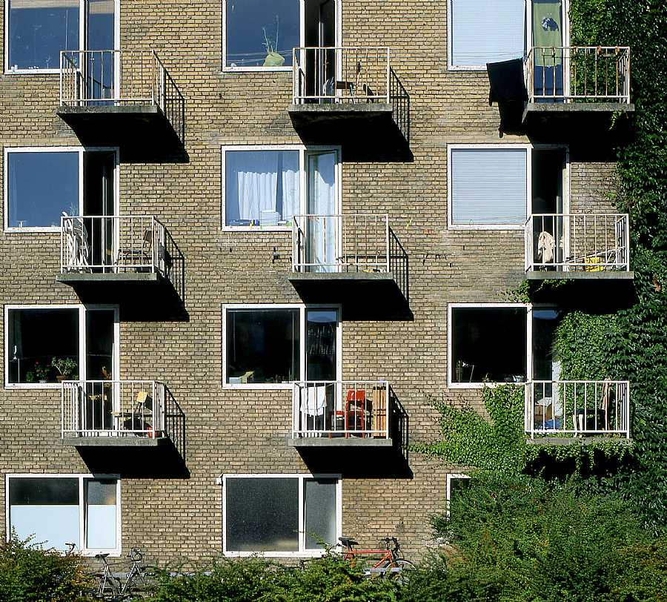
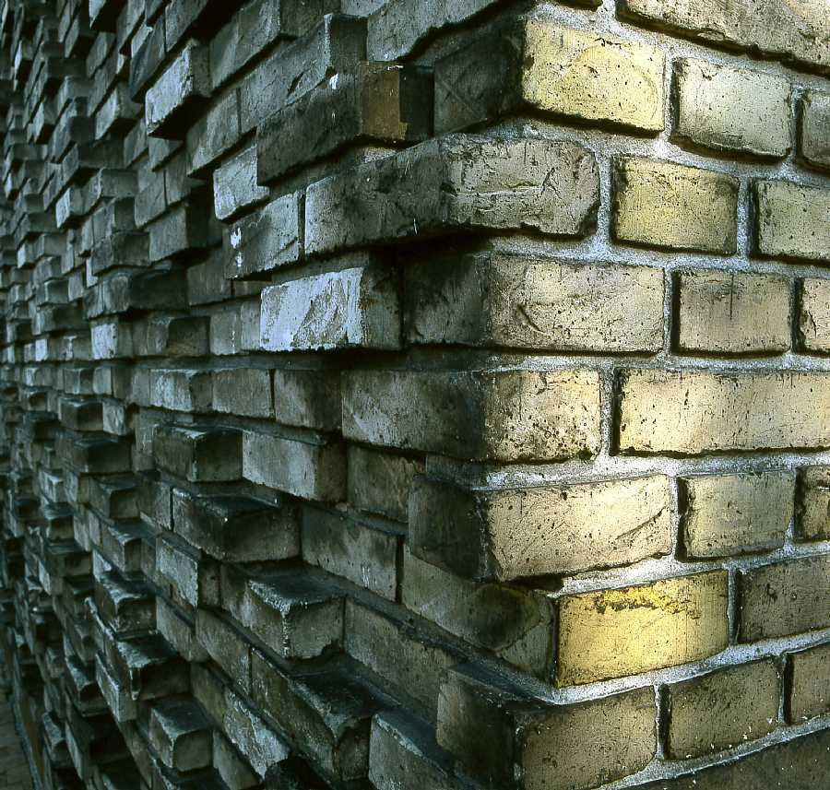
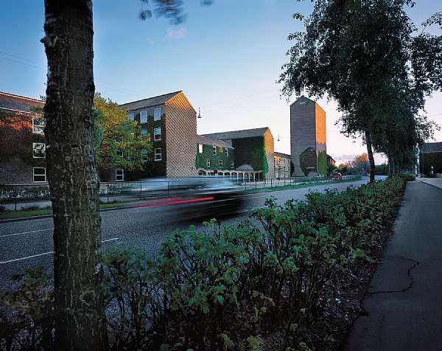
Aarhus University Campus (1931 – present)
C.F. Møller and Kay Fisker.
Park done in collaboration with C.Th. Sørensen

Slide 6
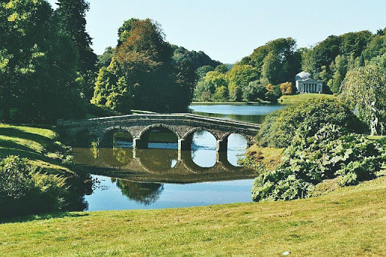
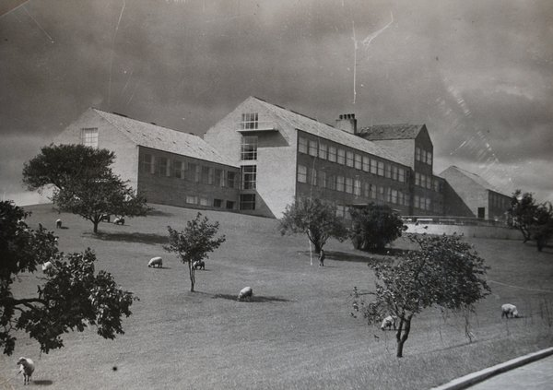
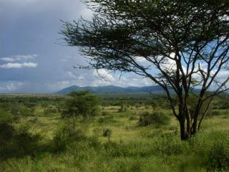
Grassing sheep in the university park 1934
Stourhead Gardens (1741-80), Wiltshire. Architect:
Henry Hoare
The university’s pastoral landscape park
East African Savanna landscape

Slide 7
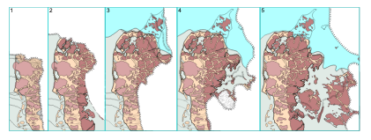
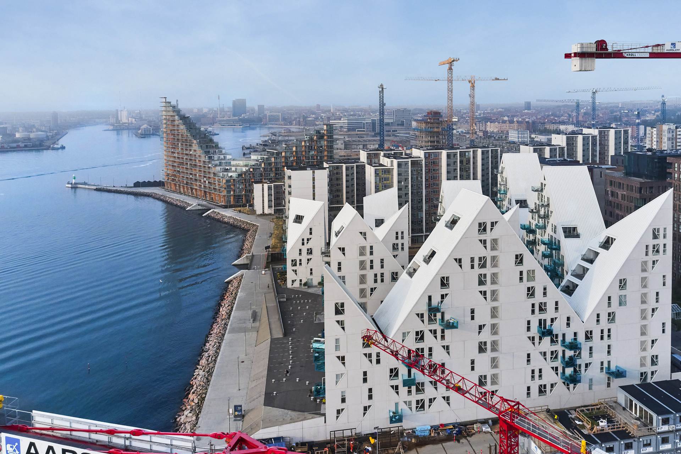
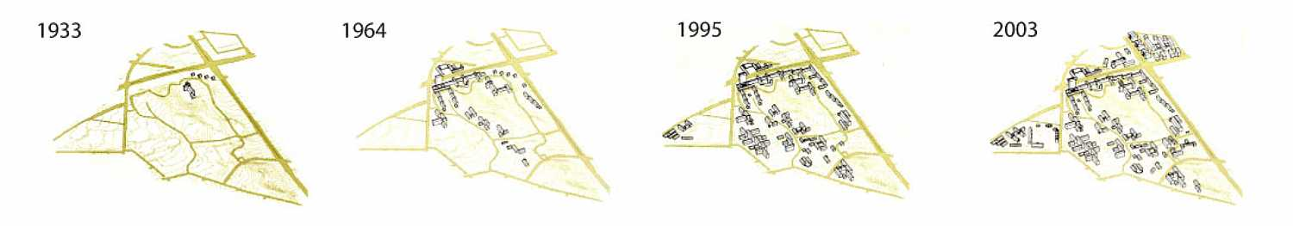
Denmark in the late ice age
The Iceberg (2013), Aarhus Harbour
18,000 before present
16,000 before present
12,000 before present
Aarhus University emerging around an ice age moraine valley

Slide 8
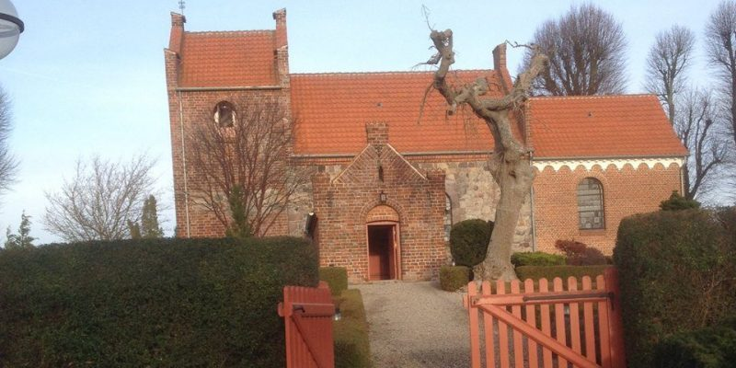
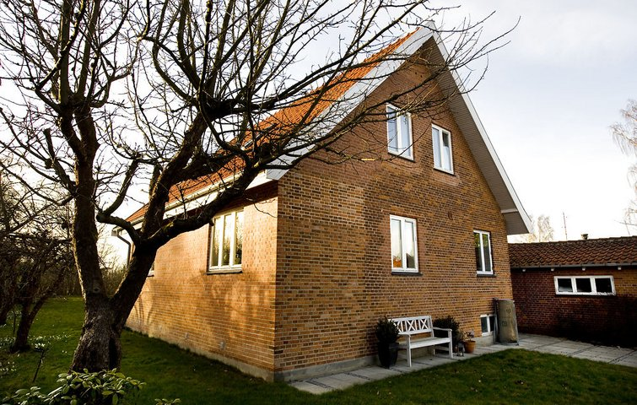
Yellow and red bricks
Both are derived from burned clay extracted from moraine deposits:
  red bricks from the upper layer of clay with oxidated iron (ferri)
  yellow bricks from the lower layer non-oxidated iron (ferro)
Most Medieval churches in DK are built from red bricks from the immediately accessible upper clay layer, but since this layer has mostly been exhausted, since 1900 most brick buildings in DK are made from yellow bricks.
Slagslunde Church (1100s – 1800s)
Typical 20th-century Danish villa

Slide 9
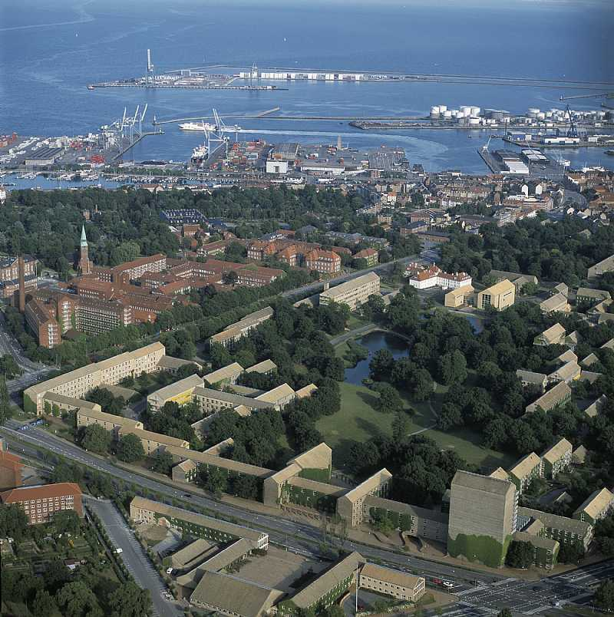
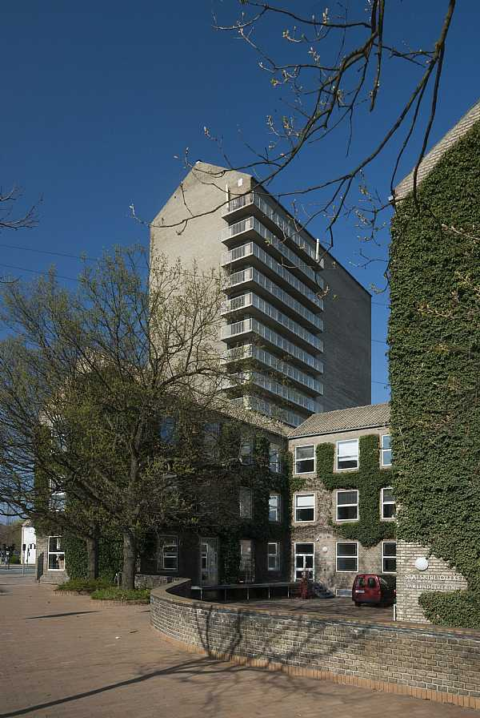
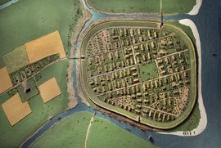
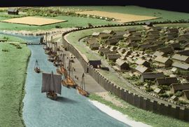
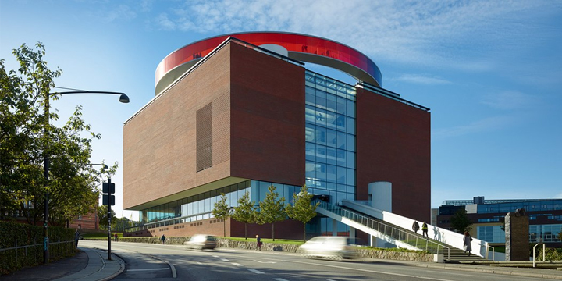
Aarhus (Aros) in the Viking Age (700-900 CE)
ARoS Art Museum
(2004) by
SHL Architects

Slide 10
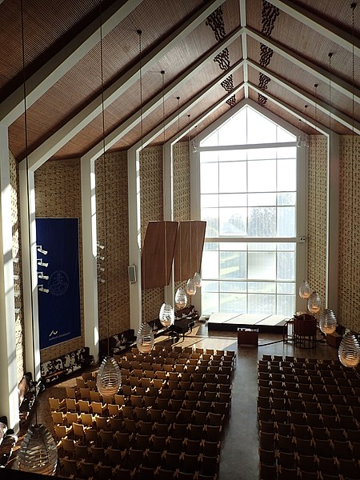
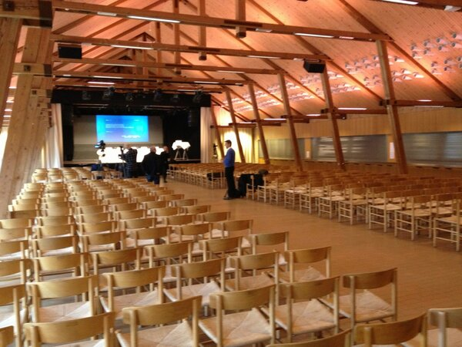
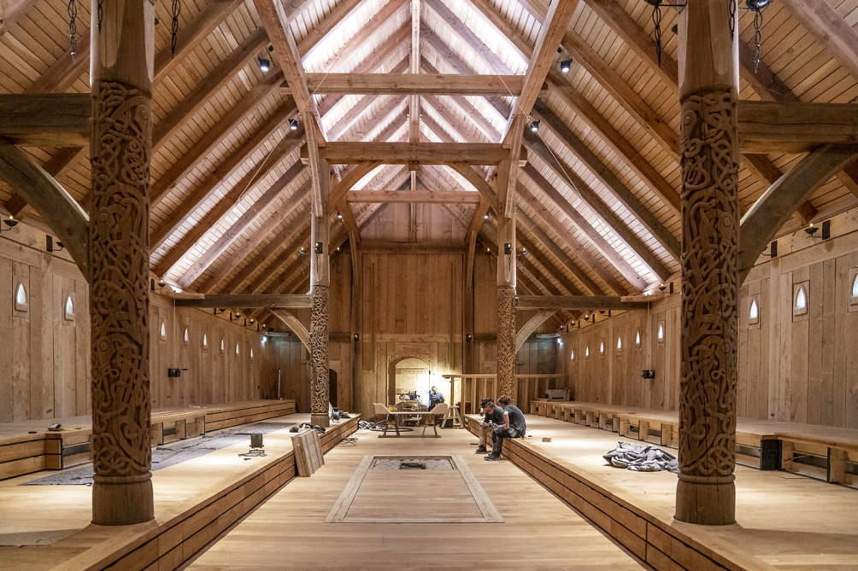
“Stakladen”, Aarhus University (1964)
Aula of Aarhus University (1946)
Reconstruction of King’s Hall, Lejre (700s; reconstr. 2020), discovered in 2009

Slide 11
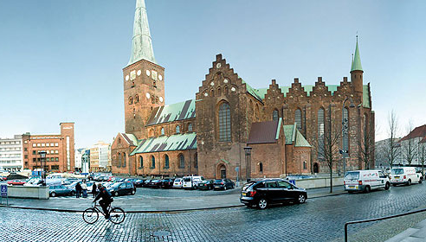
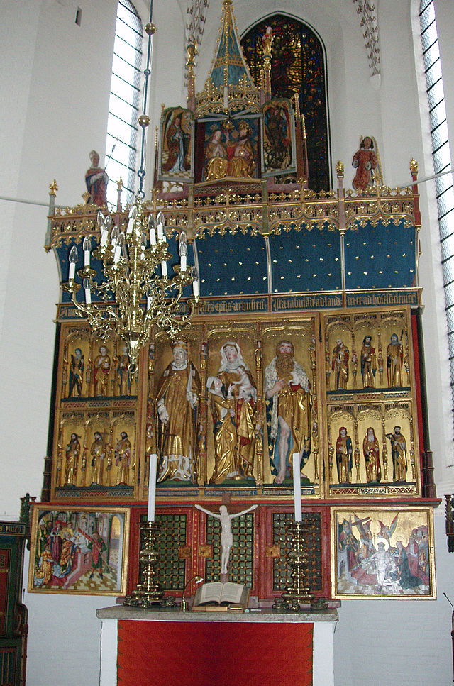
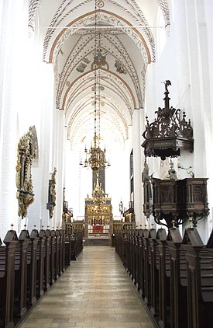
Aarhus Cathedral (ca. 1190-1480).
Altarpiece by Bernt Notke from Lübeck (late 1470s).

Slide 12
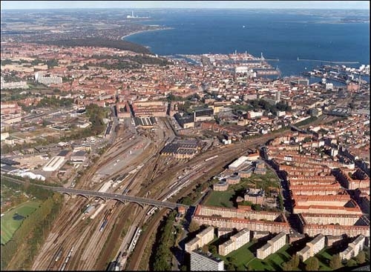
Contemporary Aarhus

Slide 13
Minilecture II:
Virtuality in a big history perspective
Jacob Wamberg
Professor of Art History, Aarhus University

Slide 14
What’s special about human history in relation to the rest of big history?
Shared virtuality: Life world is guided by an added layer of virtuality, a multitude of abstract world conceptions and perceptions, “fictions”, acquired through learning
  Ingredients of this virtual infrastructure:
    Body: Planned intentions, autonomized consciousness, autonomized emotions (feelings)
    Media: language, texts, images, rituals, music,
    sensorial environment, computers
    Ideological regimes: religion, cosmology, ethics, tribal identity, national identity, shared narratives, fiction
    Institutions: governments, municipalities, firms, money, traffic regulation
2. Technolology: The human body is adaptationally unfinished and in need of technological extensions – these are likewise developed through learning and abstract receipts
  Examples: (Media), utensils, weapons, agriculture, buildings, transport vehicles, machines, medicine

Slide 15
Consciousness: our “inner” world
The realm of the human and social sciences: The outer world as marked by the “inner” world of consciousness (subjectivity, human intentions, ideas, feelings, etc.)
?
The realm of the natural sciences:
The “outer” world as unmarked by consciousness
Raw matter: “outer” world

Slide 16
Consciousness: our “inner” world
Model 1:
Reductionist materialism: consciousness and subjective feelings are illusions that can be overcome through a thoroughly “objective” description
Raw matter: “outer” world

Slide 17
Consciousness: our “inner” world
Model 2:
Panpsychism: consciousness and subjective feelings are exported to the rest of the universe, including the so-called inanimate world
Raw matter: “outer” world

Slide 18
Consciousness: our “inner” world
Big history:
Balanced bridge building between the two realms?
Suggestion:
Virtuality may connect them.
Virtuality = potentiality, space of possibles, moving from distribution in outer world to gradual autonomization, inner world modelling inside organisms, as complexity rises.
Raw matter: “outer” world

Slide 19
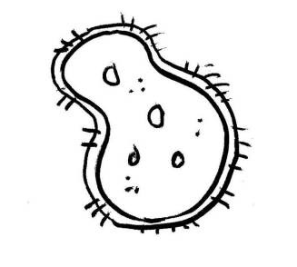
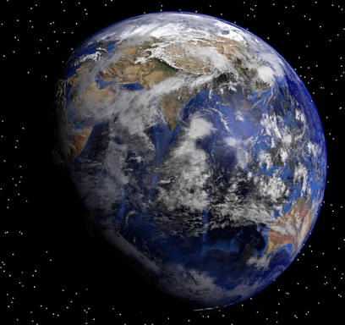
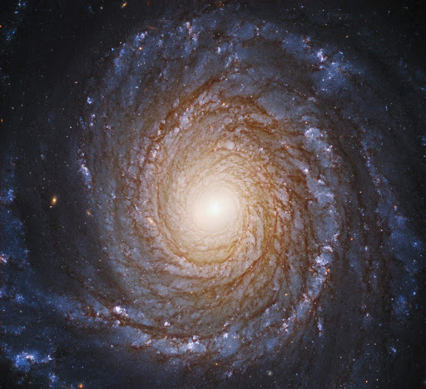
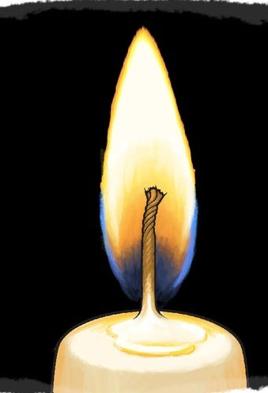
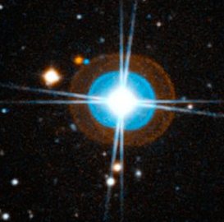
Organism = reproductive dissipative structure
Species stability
Capability of intensified negentropic evolution
Subjectivity, sign exhange
Quasi-autonomized virtuality: model of outer world
Dissipative structure = dynamic thermodynamic disequilibrium
Negentropic system, based on energy flow and export of entropy to surroundings
Thriving on the edge of order and chaos
First distinction between inner and outer world
Examples: Storms, turbulences, flames, stars, Gaia
Rising complexity
Raw matter = matter in thermodynamic equilibrium
Either low og high entropy
Highly dispersed thin virtuality
Examples: Gases, rocks, crystals, very early or very late universe

Slide 20
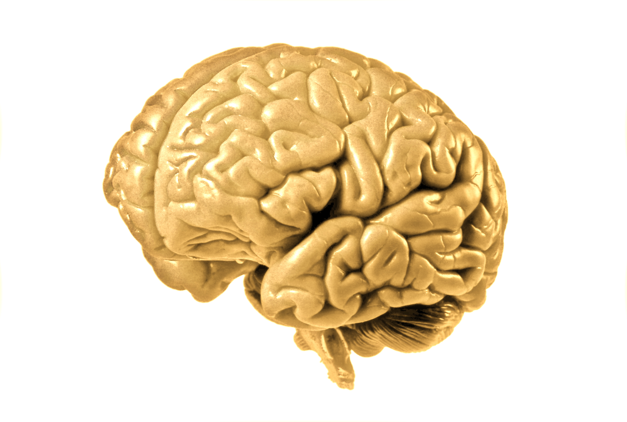
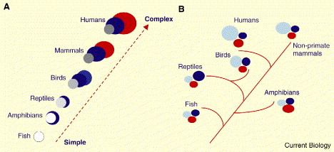
Complexification (negentropic evolution) as intensification of virtual world modeling in sensorium and brain
Changing micro-anatomical changes through cultural learning and practice:
Autonomized virtuality
Cultural brain
Permanent macro-anatomical changes through adaptation to natural environment:
Increasingly autonomized virtuality

Slide 21
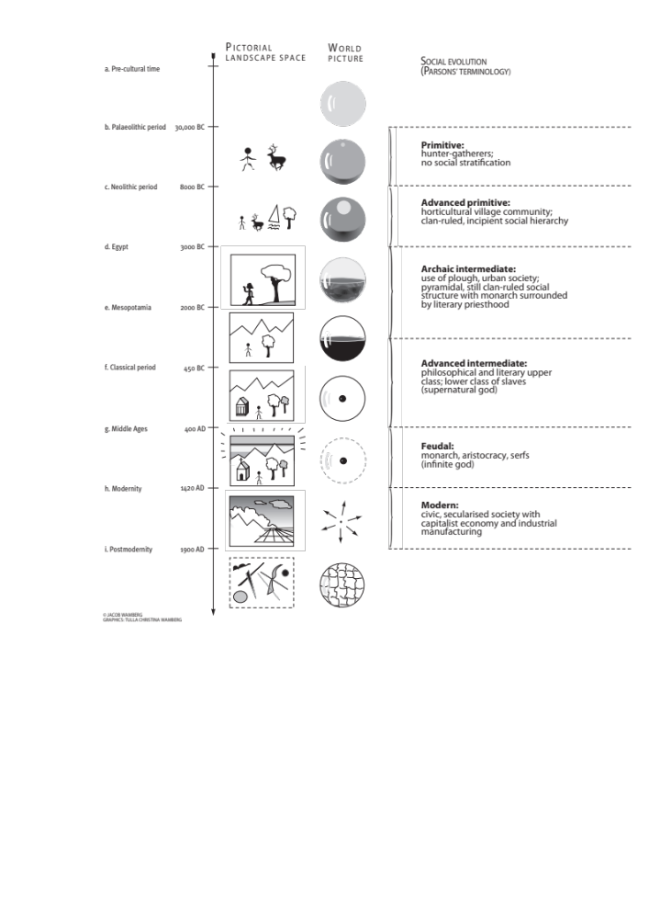

Slide 22
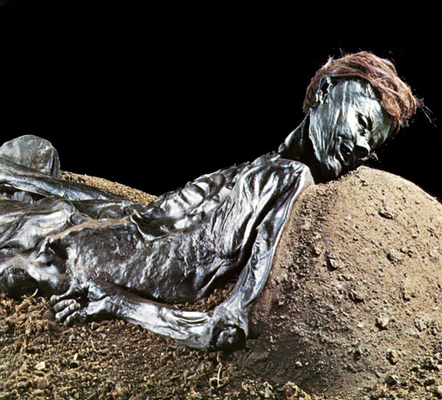
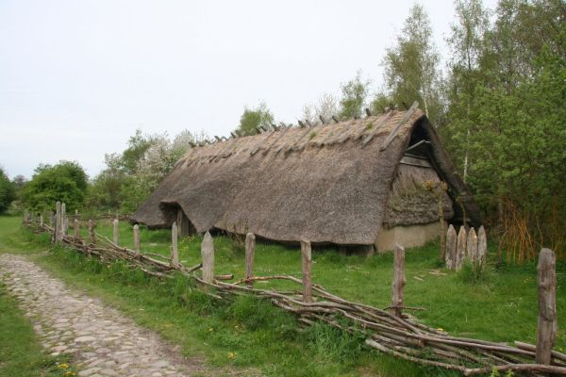
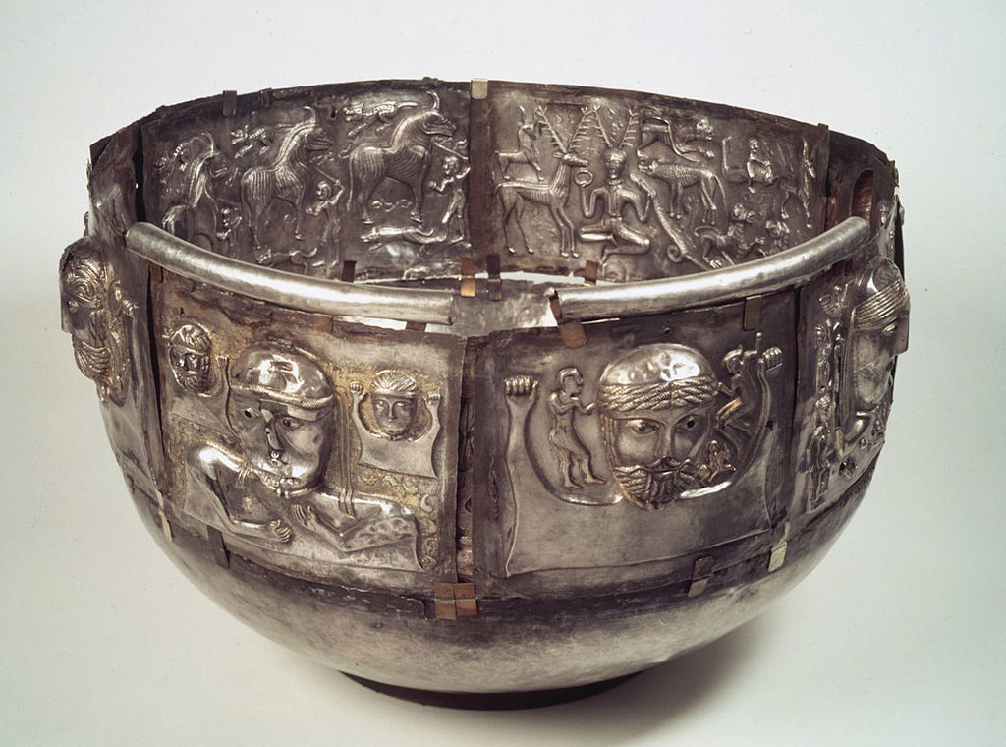
Reconstructed house from the Celtic Iron Age in Denmark (ca. 500-0 BCE)
Grauballe Man (ca. 290 BCE), found Aarhus, Moesgaard Museum
Gundestrup Cauldron (ca. 150-1 BCE), gilded silver, found in a peat bog in Northern Jutland, probably from Thrakia, NE Romania.
Copenhagen, National Museum

Slide 23
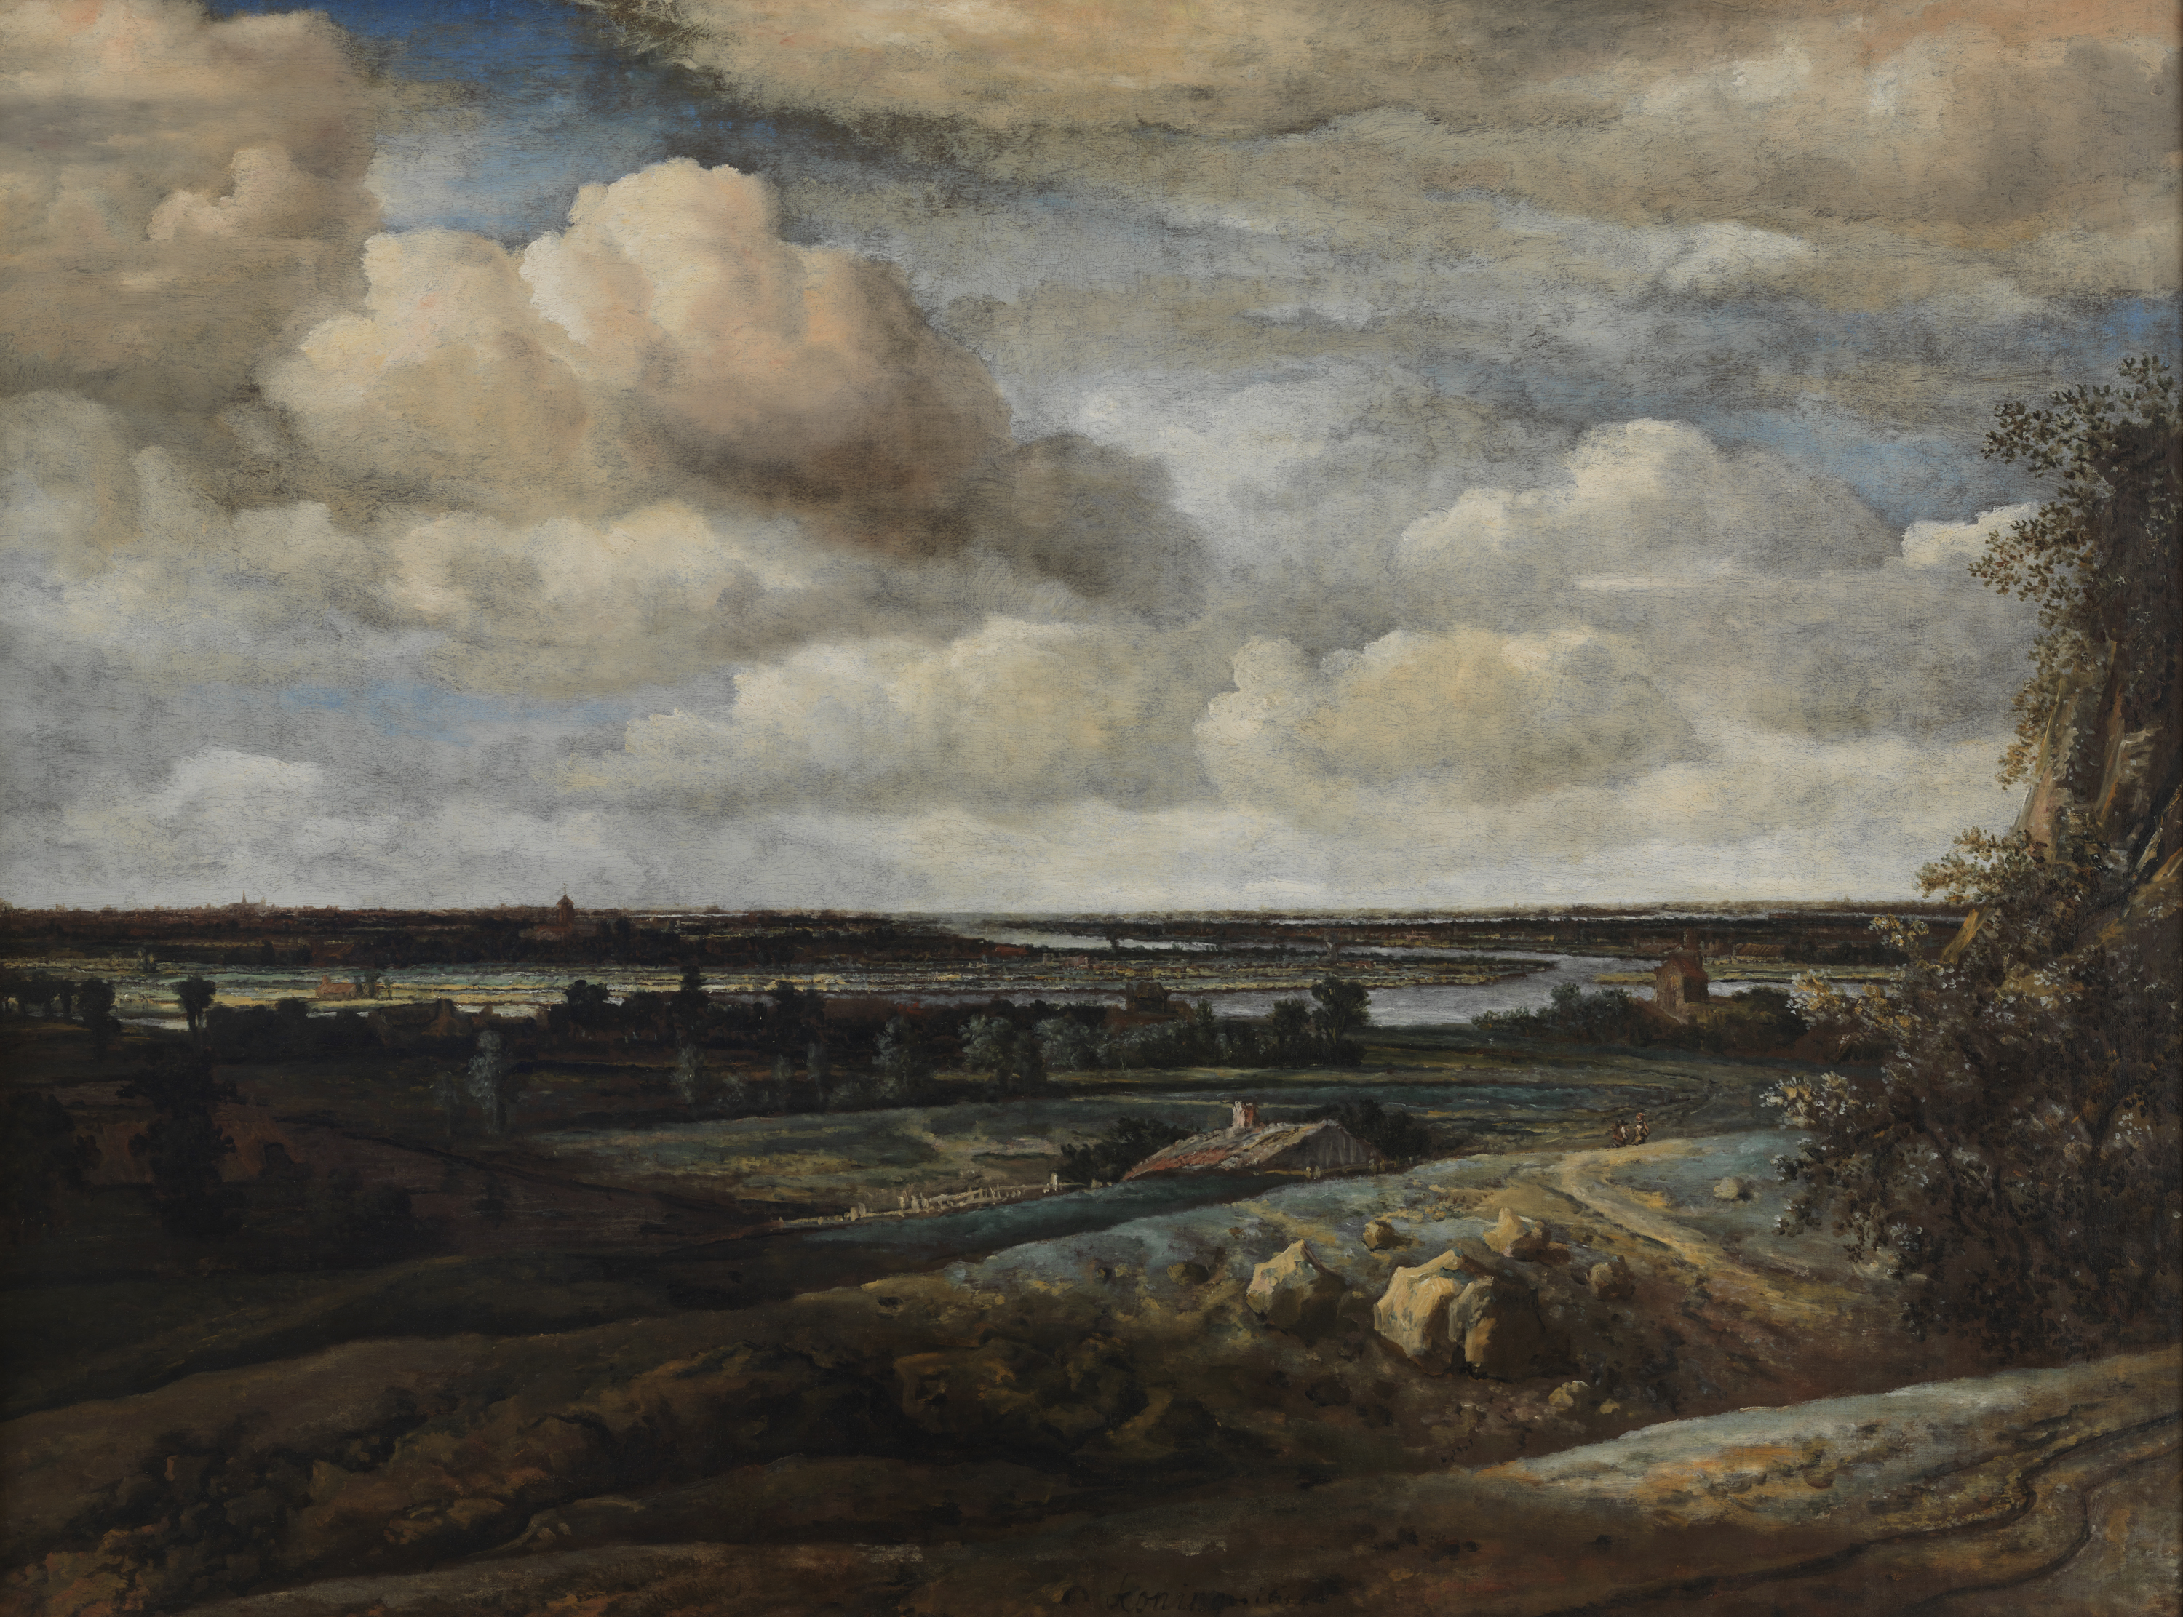
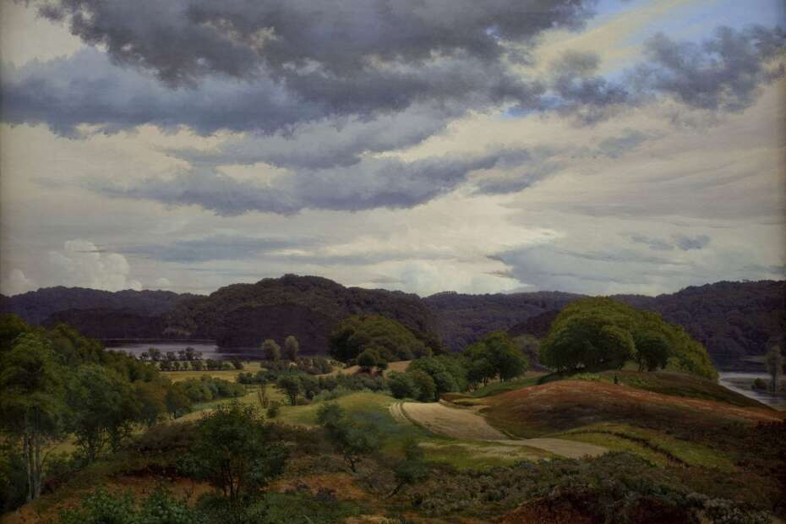
Danish Golden Age, 19th-century bourgeois culture:
Vilhelm Kyhn, Hilly landscape with lakes and woods near Silkeborg (1845), oil on canvas.
Copenhagen, Statens Museum for Kunst
Dutch Golden Age, 17th-century bourgeois culture:
Philips Koninck,
Dutch panoramic landscape with Haarlem in the distance (1654), oil on canvas.
Copenhagen, Statens Museum for Kunst

