Slide 1
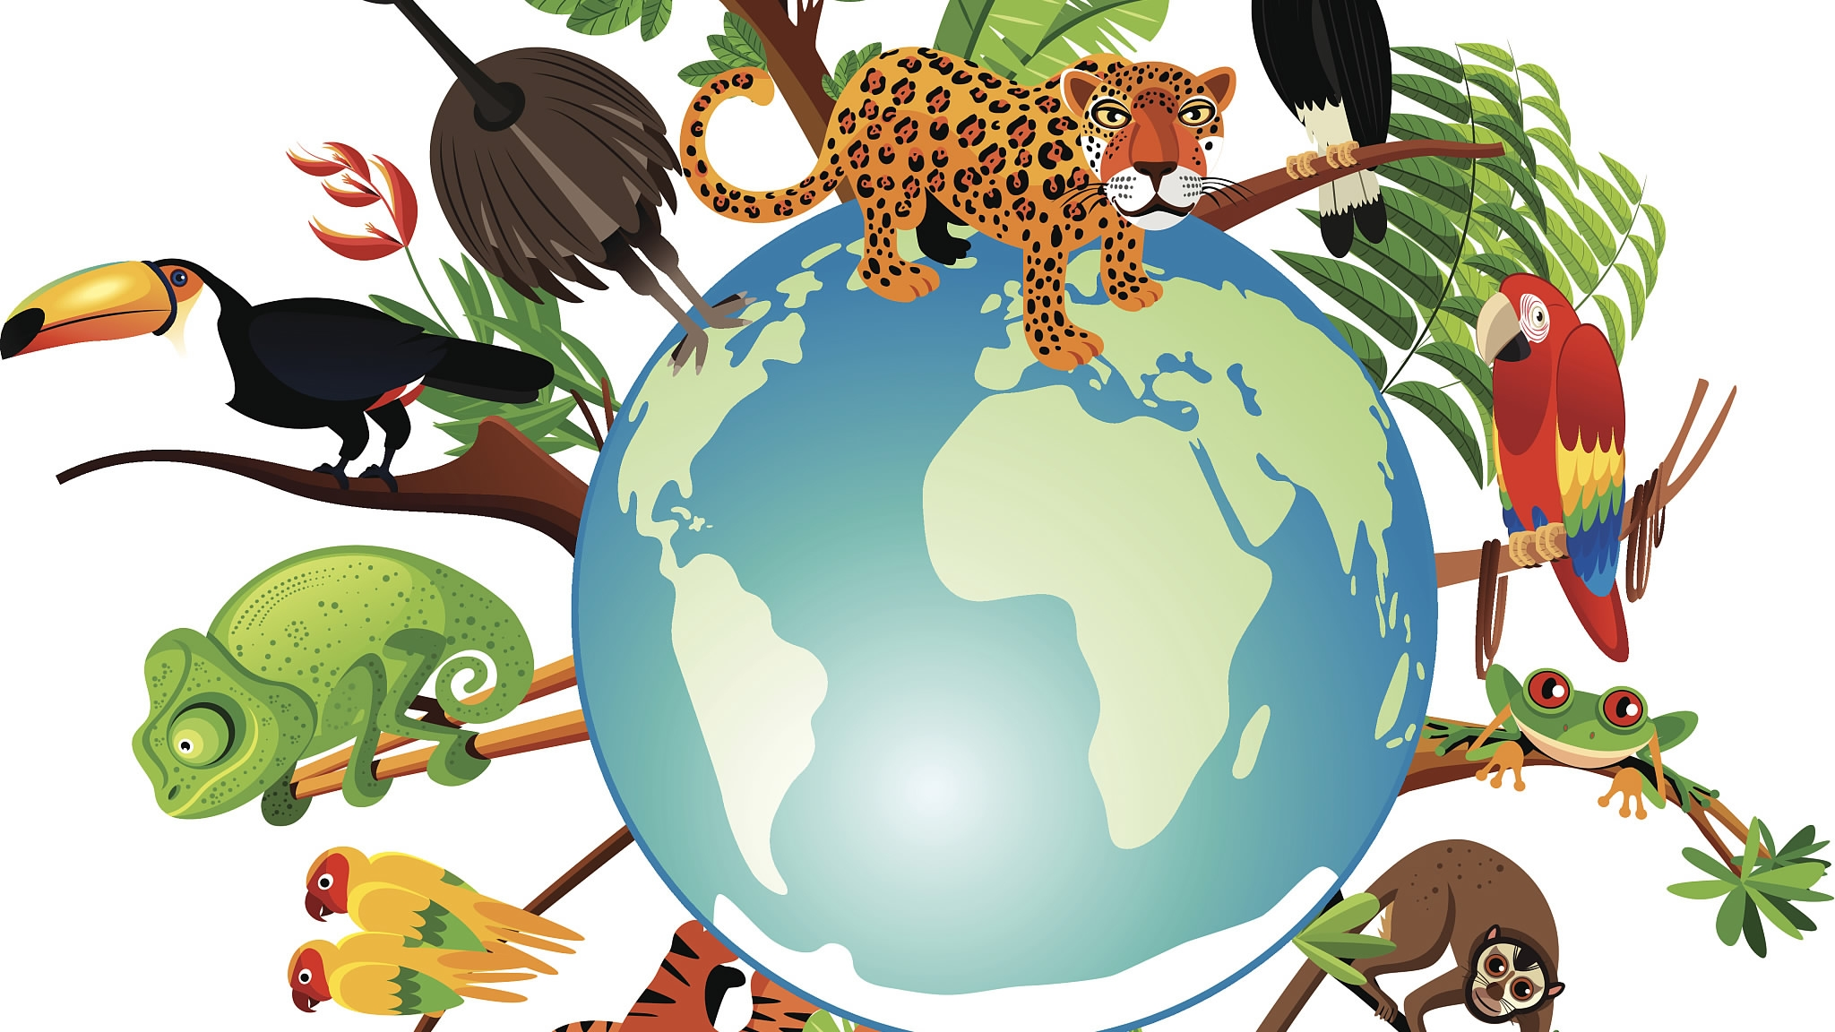
Big History e Life
Corso di perfezionamento
Didattica e divulgazione nell’Antropocene: l’approccio local Big History ry
6 november 2020
Marina Porta

Slide 2
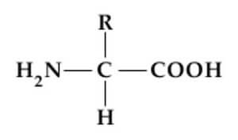
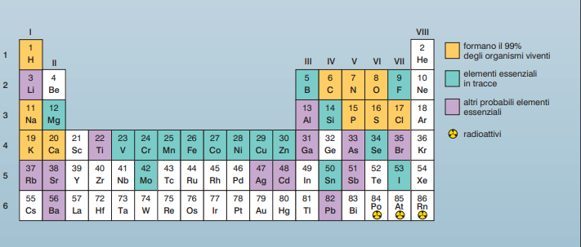
From Universe to life
Amminoacid structure

Slide 3
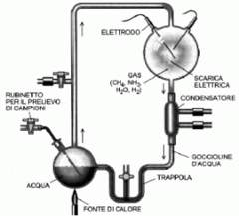
From Solar System and LIFE
Primitive atmosphere
Miller esperiment
Synthesis of amminoacid

Slide 4
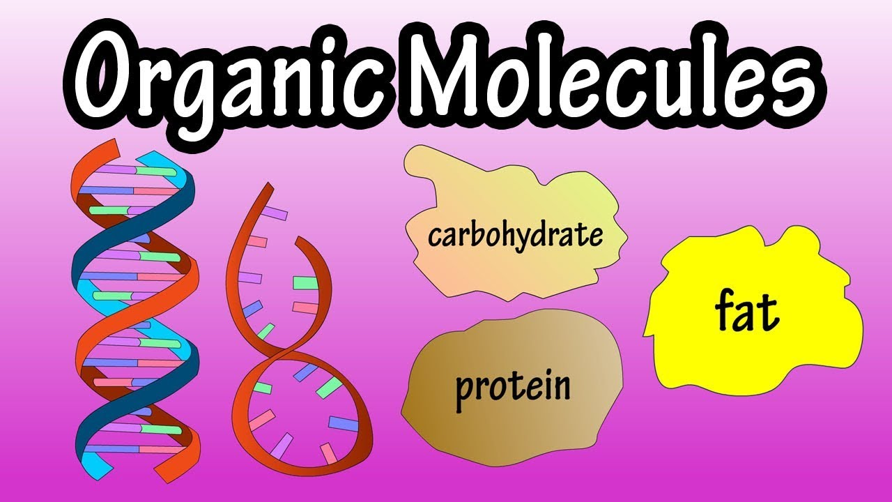

Slide 5
Complexity life’s f
Living systems are complex systems that constantly generate new information. Life, can be "Interpreted" as an order which, emerging from chaos, is able to self-assemble into always different ways, also producing a type of information. The novelty of information is intrinsic to the dynamics of the process (for example in ontogenesis). The system continually redefines the space of alternatives and cannot in any way be compared to a program that, as is known at all, it is based on pre-defined rules. We thus pass from the deterministic model in which everything is platonically pre-established (e.g. the immutable ideas present in Hyperuranium), to the interpretation of DNA as a complex system capable of always creating new ones meanings (qualitatively always different information). The new vision will no longer be linked to a deterministic program, but to a bundle of capabilities (unpredictable possibilities), that is, to rules capable of self-regulating and changing into relation to the environment.
Emergent proprieties

Slide 6
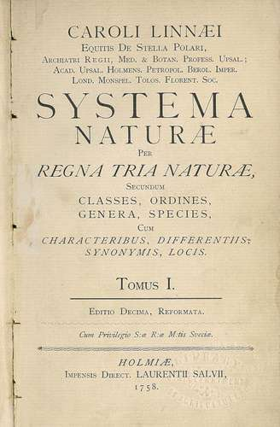
Life is biodiversity

Slide 7
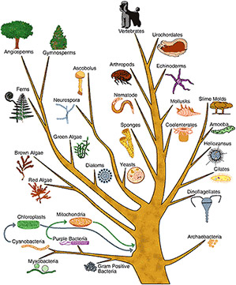
Tree of the life
Life is evolution

Slide 8
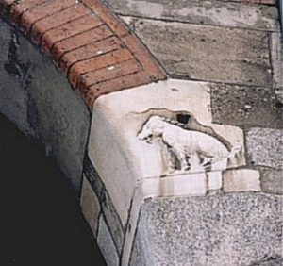
Life, myths and locaL BIG History
The best known sees in the Roman-Gallic etymology of Mediolanum a "middle ground". The interpretation "in half wool" is supported by the symbol of the semi-woolly pork.
The first human settlement seems to date back to the Bronze Age, around the second millennium BC, but it seems that the origin of Milan is due to the Insubri, people of Celtic culture from Gaul.According to the Roman historian Titus Livio (59 BC - 17 AD), the first settlement was established in the middle of the Po Valley around 600 BC by a tribe of Gauls Biturgi led by Belloveso, defeating the Etruscan populations.Titus Livy was based on a legend, dear then to tradition, according to which the name comes from the discovery by Belloveso of a sow semilanuta (in medio lanae) that was seen as a propitious sign for the foundation of a village, this then became the symbol of Gallic Milan until the fourth century.Translated with www.DeepL.com/Translator (free version)
The sow was considered a sacred animal by the Celts and the leader interpreted the apparition as a divine sign, an invitation to build a new city on that very spot.
In that place Medhe-lan was born, which in Gallic means middle ground.

Slide 9
…. local big history narration
The infection with Yersinia pestis, the bacterium responsible for the plague, began to affect humanity about 3300 years before it was reconstructed according to historical records. This is what emerges from the sequencing of DNA obtained from samples of teeth dating back to the Bronze Age and belonging to European and Asian individuals who lived between 5000 and 2800 years ago, on which they report in the journal "Cell" Eske Willerslev of the University of Copenhagen and colleagues. However, it took the bacterium another thousand years or so to develop its terrible pathogenic effects, when two key mutations allowed it to use rat fleas as vectors and evade the attack of the host's immune system.

Slide 10
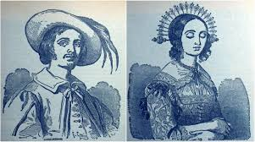
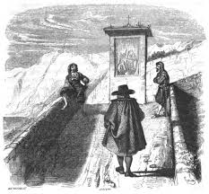
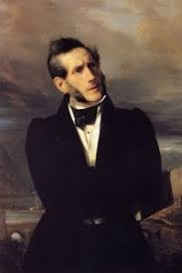
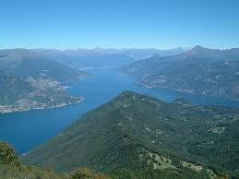
It is the terrible epidemic that broke out in Northern Italy between 1630 and 1631, decimating the population and raging with particular virulence in the city of Milan, then one of the most populous in the region: it is described in the final pages of the novel, in particular in chapters XXXI-XXXII of Promessi Sposi wrote by Alessandro Manzoni entirely occupied by a historical digression that reconstructs the spread of the disease and its dramatic consequences (the novelist's description has rightly remained famous and is still remembered as one of the highest moments of his literary work).
that branch of Como lake

Slide 11
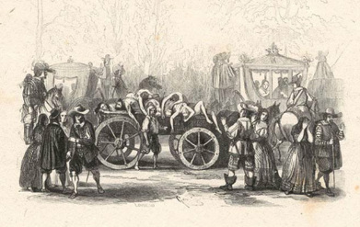
The contagion was brought to Lombardy by the descent of the German troops under the command of Albrecht von Wallenstein, who penetrated from the Valtellina directed to Mantua to lay siege to the city and in whose ranks the plague was endemic for a long time.

Slide 12
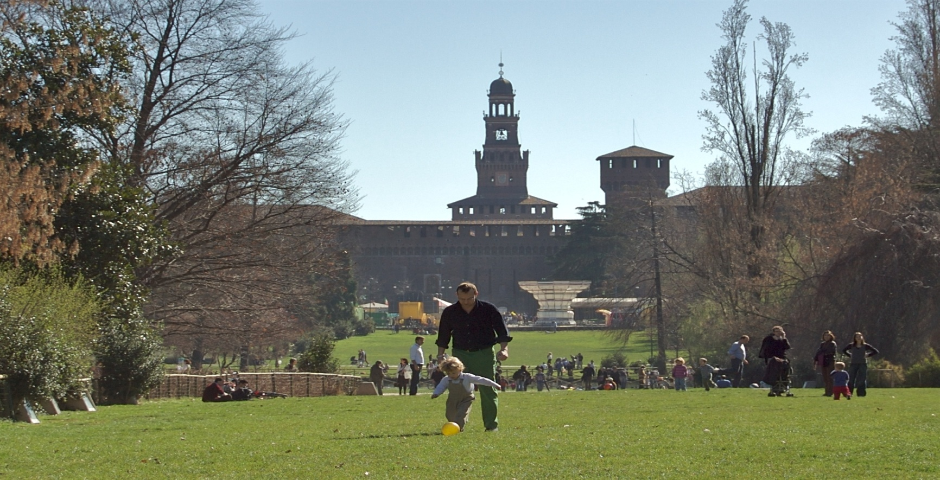
LBH and life: around Sempione park by learning the trees
https://www.comune.milano.it/documents/20126/2049613/Parco+Sempione-percorso+botanico-alberi.pdf/868e9bbe-1260-a5b2-2233-3054dd729d4d?t=1581336782984
Milan isn’t only a concentrate of the houses but there’ s the possibility to learn botanic sistematic travelling around the artistic monuments

Slide 13
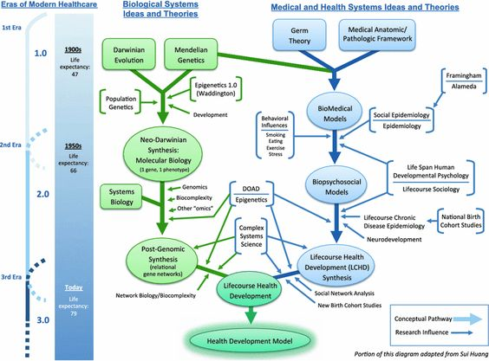
Biology and society: past and future

Slide 14

Biology and society: present

Slide 15
Thanks or the attention

